Slide 1
What Users Want
Laura Klein
Principal, Users Know
laura@usersknow.com
@lauraklein
Combining Qualitative Research, Quantitative Analytics, and Vision to Create Great Products

Slide 2
What is Quantitative Data?
Information that can be expressed statistically about your customers
Some ways to gather Quantitative Data:
  A/B Testing
  Customer Metrics
  Analytics
  Funnel Analysis

Slide 3
What is Qualitative Data?
Non-statistically significant information gathered directly from your users
Some ways to gather Qualitative Data:
  Usability Testing
  User Observations & Contextual Inquiry
  Customer Development
  User Interviews

Slide 4
What is Vision?
The entire design process
Design vision should include:
  Having a strong opinion about what your product is and how it should work
  Developing creative solutions to customer problems

Slide 5
Once Upon a Time…

Slide 6
Story #1
Vision: When Designers Decide

Slide 7
The Moral of Story #1:
Vision is incredibly important to Design
Relying solely on Vision is dangerous
Vision must be supported by data

Slide 8
Story #2
Research: When Customers Decide

Slide 9
The Moral of Story #2:
Listening to users is incredibly important
Listening does not mean doing whatever they ask
Qualitative Data must be supported by common sense and math

Slide 10
Story #3
Metrics: When Engineers Decide

Slide 11
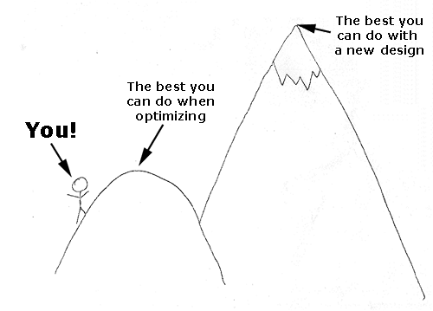
The Local Maximum Problem

Slide 12
The Moral of Story #3:
Metrics are incredibly important
Metrics don’t tell you why problems are happening
Quantitative Data must be supported by vision and talking to users

Slide 13
Story #4:
A Better Approach: Combining All Three Methods

Slide 14
Quantitative Data answers What
  What features do my customers use most?
  What are my users doing?
  What branch of the experiment is winning?

Slide 15
Qualitative Data answers Why
  Why are users getting stuck?
  Why are users doing what they are doing?
  Why do users prefer one branch of an experiment to another?

Slide 16
Vision answers How
  How can I fix the problems I’ve observed?
  How can I get my users to behave the way I’d like.
  How can I make my users happy?

Slide 17
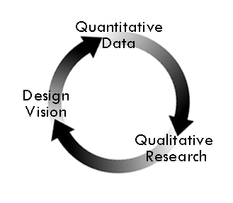
The Ideal Flow

Slide 18
The Moral of Story #4
  No single approach can solve this problem
  Combining qualitative research, quantitative data, and vision gives you a better process and a better product

Slide 19
Story #5:
A Real Story: Improving the Experience at IMVU

Slide 20
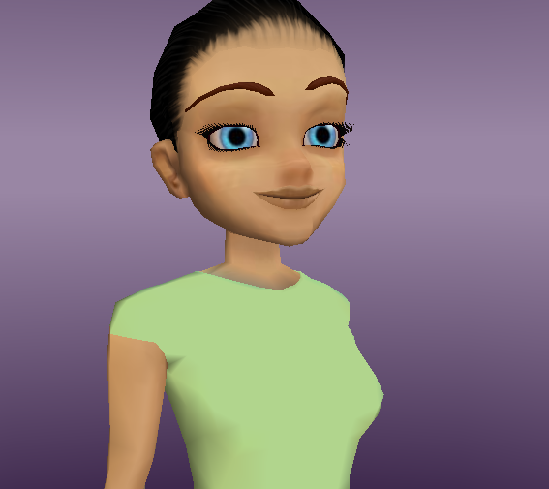
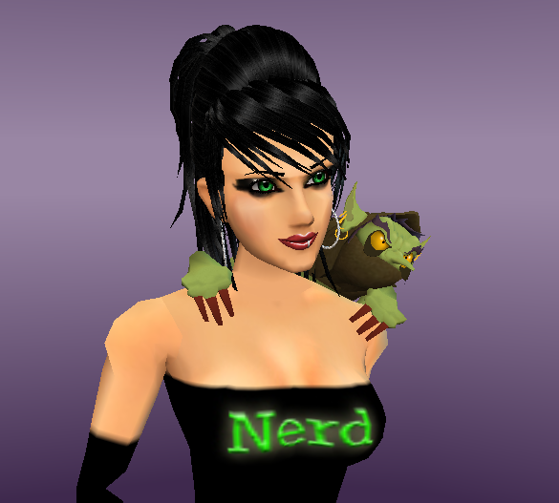
Standard Avatar
Custom Avatar

Slide 21
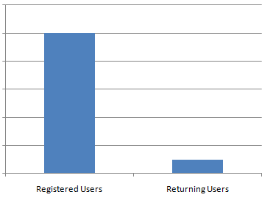
WHAT is the problem?
Getting users to return.

Slide 22
WHY is this problem happening?
Hypothesis: People don’t find the dress up experience compelling.

Slide 23
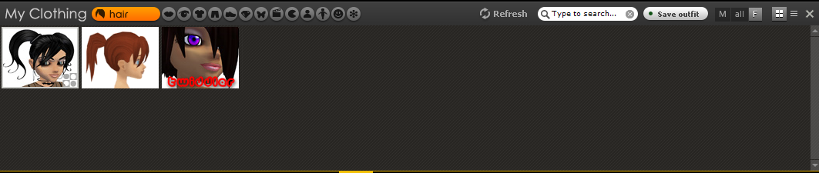
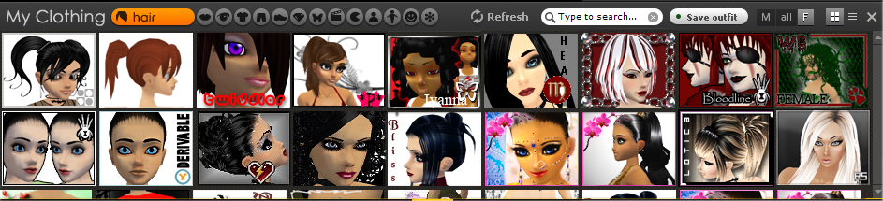
How do we fix it?
Few Products
More Products
Give people more products to improve the initial dress up experience.

Slide 24
NOW DO IT AGAIN!
(iterate)

Slide 25
The Moral of the Story

Slide 26
Story #6:
An Unfinished Story: Food on the Table

Slide 27

What is the problem?
People aren’t making it all the way through the first time user experience.

Slide 28
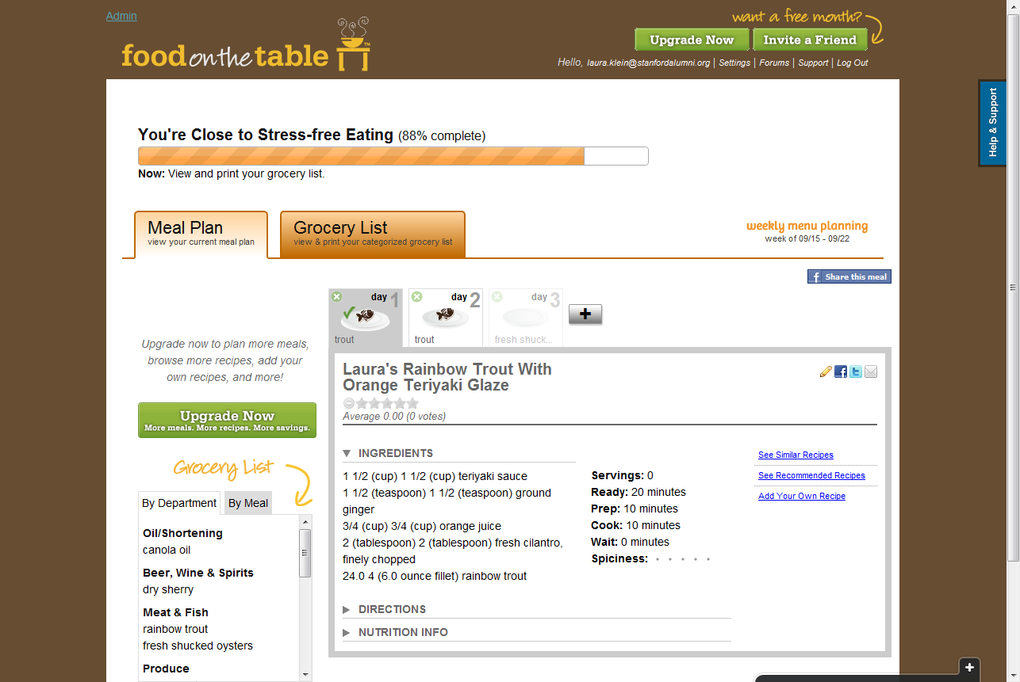
Why is this problem happening?
People get confused by the navigation of the site and don’t know what they’re supposed to do next.

Slide 29
How do we fix it?
To Be Continued…(check the blog!)

Slide 30
And they lived happily ever after…
(Except…)

Slide 31
A Few Common Problems
Problem: Not enough users for good quantitative data
Solutions:
Get more users (by any means necessary)
Rely more heavily on qualitative data until you’ve got enough people

Slide 32
A Few Common Problems
Problem: Qualitative research takes too much time
Solutions:
Suck it up, cupcake
Try online tools to make it go faster
  usertesting.com
  Ethnio
  FiveSecondTest
  Remote Testing with GoToMeeting, WebEx, Skype

Slide 33
A Few Common Problems
Problem: We have too many great ideas!
Solutions:
Always use data to help validate your design visions (and keep designers honest)
Be aggressive about checking your decisions against the original problem

Slide 34
And they lived happily ever after…
(because their products were awesome!)

Slide 35
Q&A
Contact Me:
Laura Klein, Users Know
@lauraklein
http://usersknow.blogspot.com
laura@usersknow.com

